Slide 1

Dart Operators

Slide 2
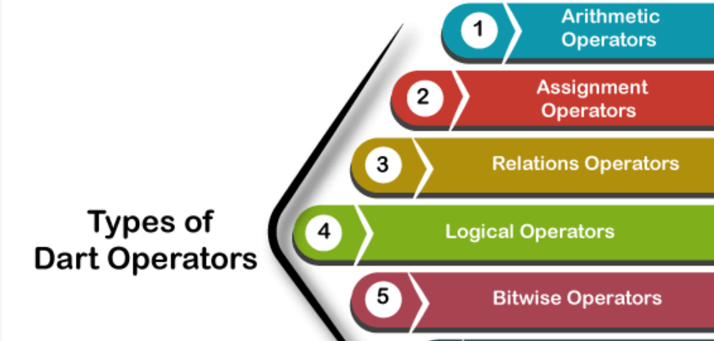
Types of Operators
Dart supports the following types of operators:
Arithmetic Operators
Assignment Operators
Relational Operators
Type test Operators
Logical Operators
Bitwise Operator

Slide 3
 | Operator Name
1. | Addition(+)
2. | Subtraction(-)
3 | Divide(/)
4. | Multiplication(*)
5. | Modulus(%)
6. | Division(~/)
7. | Unary Minus(-expr)

Slide 4
Dart Unary Operators (post and pre)
 | Operator Name
1. | ++(Prefix)
2. | ++(Postfix)
3. | --(Prefix)
4. | --(Postfix)

Slide 5
Assignment Operator
Operators
= (Assignment Operator)
+=(Add and Assign)
-=(Subtract and Assign)
*=(Multiply and Assign)
/=(Divide and Assign)
~/=(Divide and Assign)
%=(Mod and Assign)

Slide 6
Relational Operator
 | Operator
1. | >(greater than)
2. | <(less than)
3. | >=(greater than or equal to)
4. | <=(less than or equal to)
5. | ==(is equal to)
6. | !=(not equal to)

Slide 7
Dart Type Test Operators
 | Operator
1. | is
2. | is!

Slide 8
Dart Logical Operators
 | Operator
1. | &&(Logical AND)
2. | ||(Logical OR)
3. | !(Logical NOT)

Slide 9
Dart Bitwise Operators
 | Operators
1. | &(Binary AND)
2. | |(Binary OR)
3. | ^(Binary XOR)
4. | ~(Ones Compliment)
5. | <<(Shift left)
6. | >>(Shift right)

